Slide 1
Lecture 19: Introduction to Sorting
CSE 373: Data Structures and Algorithms

Slide 2
Lecture XX Sorting
Department of Computer Science
Hofstra University
Acknowledgement: Lecture slides based on UofW Course on Data Structures

Slide 3
Warm Up
If I handed you a stack of papers and asked you to sort them by author name alphabetically, how would you do it?
Selection Sort - Flip through the stack from front to back looking for the first name, then pull it to the front. Then I would flip through again looking for the second name and put it behind the first and so on until all were sorted
Insertion Sort - Look at the first two papers and put them in sorted order, then look at the third and put it in sorted order with the previous two and continue until the whole stack is in sorted order
Merge Sort - Spread the papers out on the ground and break them into subsections, sort the subsections section by section then put them all back together
Bucket Sort - Put the papers into groups based on the first letter of the author’s name until I had 26 piles, then sort within those piles and put them all back together

Slide 4
Intro to Sorting
Selection Sort
Insertion Sort
Merge Sort
Quick Sort

Slide 5
Types of Sorts
Comparison Sorts
Compare two elements at a time
General sort, works for most types of elements
What does this mean?
compareTo() works for your elements
And for our running times to be correct, compareTo() must run in O(1) time
Niche Sorts aka “linear sorts”
Leverages specific properties about the items in the list to achieve faster runtimes
niche sorts typically run O(n) time
For example, we’re sorting integers, or strings where we sort by digit or character

Slide 6
Stable Sort, In-Place Sort
A stable sorting algorithm is one that maintains the relative order of elements with equal keys in the sorted output as they appeared in the input
e.g., Bubble Sort, Insertion Sort, Merge Sort, Radix Sort
Stability is important when multiple sorting operations are performed on data with multiple keys. For example, if you first sort a list of students by name and then by grade, a stable sort will ensure that students with the same grade remain sorted by name. This characteristic is crucial in scenarios where secondary attributes need to be preserved after sorting by primary attributes.
In-place sort
A sorting algorithm is in-place if it modifies input array and does not allocate extra memory. Useful for minimizing memory usage
Name | Grade
Bas | 60
Frank | 80
Jana | 60
Jouni | 60
Lara | 20
Nick | 80
Rose | 60
Sam | 40
Name | Grade
Lara | 20
Sam | 40
Bas | 60
Jana | 60
Jouni | 60
Rose | 60
Frank | 80
Nick | 80
These lines do not cross
Sorting by the Grade attribute (the key) maintains the relative order of the Name attribute for persons with equal Grade
Notes:
Stable sort
A sorting algorithm is stable if any equal items remain in the same relative order before and after the sort
Why do we care?
“data exploration” Client code will want to sort by multiple features and “break ties” with secondary features
Stable - fox remains before cow
[(8, “fox”), (9, “dog”), (4, “wolf”), (8, “cow”)] [(4, “wolf”), (8, “fox”), (8, “cow”), (9, “dog”)] [(4, “wolf”), (8, “cow”), (8, “fox”), (9, “dog”)]

Slide 7
Principle 1
Invariants/Iterative improvement
Step-by-step, make one more part of the input your desired output
We’ll write iterative algorithms to satisfy the following invariant:
After k iterations of the loop, the first k elements of the array will be sorted.

Slide 8
Intro to Sorting
Insertion Sort
Selection Sort
Merge Sort
Quick Sort

Slide 9
Insertion Sort
Insertion sort works by iteratively inserting each element of an unsorted list into its correct position in a sorted portion of the list. It is like sorting playing cards in your hands. You split the cards into two groups: the sorted cards and the unsorted cards. Then, you pick a card from the unsorted group and put it in the right place in the sorted group.
Start with second element of the array as first element in the array is assumed to be sorted.
Compare second element with the first element and check if the second element is smaller then swap them.
Move to the third element and compare it with the first two elements and put at its correct position
Repeat until the entire array is sorted.
Time complexity: O(n²), as there are two nested loops:
Outer loop to select each element in the unsorted group one by one, with O(n) complexity
Inner loop to insert that element into the sorted group, with O(n) complexity
Insertion Sort | GeeksforGeeks
https://www.geeksforgeeks.org/insertion-sort-algorithm/
https://www.geeksforgeeks.org/time-and-space-complexity-of-insertion-sort-algorithm/
https://www.youtube.com/watch?v=OGzPmgsI-pQ

Slide 10
Insertion Sort
0 | 1 | 2 | 3 | 4 | 5 | 6 | 7 | 8 | 9
2 | 3 | 6 | 7 | 5 | 1 | 4 | 10 | 2 | 8
Sorted Items
Current Item
Unsorted Items
0 | 1 | 2 | 3 | 4 | 5 | 6 | 7 | 8 | 9
2 | 3 | 5 | 6 | 7 | 8 | 4 | 10 | 2 | 8
Sorted Items
Unsorted Items
Current Item
0 | 1 | 2 | 3 | 4 | 5 | 6 | 7 | 8 | 9
2 | 3 | 5 | 6 | 7 | 8 | 4 | 10 | 2 | 8
Sorted Items
Unsorted Items
Current Item

Slide 11



Insertion Sort
0 | 1 | 2 | 3 | 4 | 5 | 6 | 7 | 8 | 9
2 | 3 | 5 | 6 | 7 | 8 | 4 | 10 | 2 | 8
Sorted Items
Unsorted Items
Current Item
public void insertionSort(collection) {
for (entire list)
if(currentItem is smaller than largestSorted)
int newIndex = findSpot(currentItem);
shift(newIndex, currentItem);
}
public int findSpot(currentItem) {
for (sorted list going backwards)
if (spot found) return
}
public void shift(newIndex, currentItem) {
for (i = currentItem > newIndex)
item[i+1] = item[i]
item[newIndex] = currentItem
}
Worst case runtime?
Best case runtime?
Average runtime?
Stable?
In-place?
Useful for:
Yes
Yes
Mostly sorted collections of primitives

Slide 12
Insertion Sort Stability
✓
0 | 1 | 2 | 3 | 4 | 5 | 6
5a | 3 | 4 | 5b | 2 | 6 | 8
Insertion sort is stable
All swaps happen between adjacent items to get current item into correct relative position within sorted portion of array
0 | 1 | 2 | 3 | 4 | 5 | 6
5a | 3 | 4 | 5b | 2 | 6 | 8
0 | 1 | 2 | 3 | 4 | 5 | 6
3 | 5a | 4 | 5b | 2 | 6 | 8
✓
0 | 1 | 2 | 3 | 4 | 5 | 6
3 | 4 | 5a | 5b | 2 | 6 | 8
0 | 1 | 2 | 3 | 4 | 5 | 6
3 | 4 | 5a | 5b | 2 | 6 | 8
Notes:
Duplicates will always be compared against one another in their original orientation, thus it can be maintained with proper if logic

Slide 13
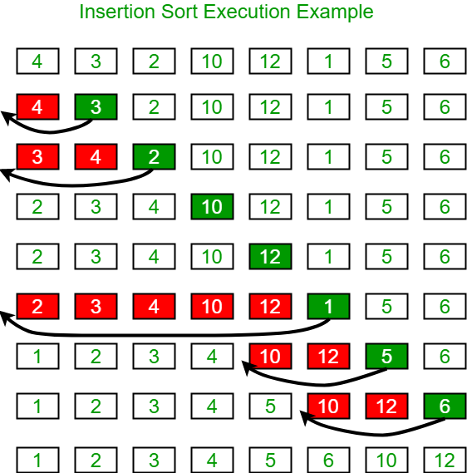
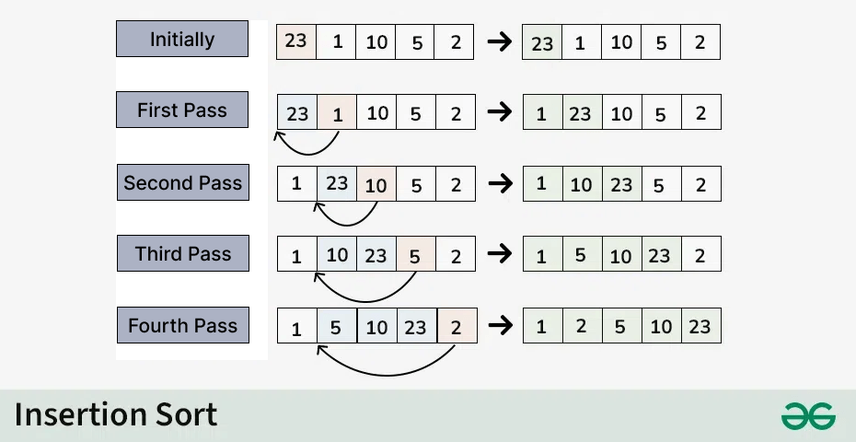
Insertion Sort: More Examples

Slide 14
Intro to Sorting
Insertion Sort
Selection Sort
Merge Sort
Quick Sort

Slide 15
Selection Sort
Selection Sort works by repeatedly selecting the smallest element from the unsorted portion and swapping it with the first unsorted element. This process continues until the entire array is sorted.
First we find the smallest element and swap it with the first element. This way we get the smallest element at its correct position.
Then we find the smallest among remaining elements (or second smallest) and move it to its correct position by swapping.
Keep going until all elements are sorted.
Selection Sort | GeeksforGeeks
https://www.geeksforgeeks.org/selection-sort-algorithm-2/
https://www.geeksforgeeks.org/time-and-space-complexity-analysis-of-selection-sort/
https://www.youtube.com/watch?v=xWBP4lzkoyM
4
7
2
10
1
8
unsorted
1
7
2
10
4
8
sorted
unsorted
1
2
7
10
4
8
sorted
unsorted
1
2
4
10
7
8
1
2
4
7
10
8
1
2
4
7
8
10

Slide 16
Selection Sort
0 | 1 | 2 | 3 | 4 | 5 | 6 | 7 | 8 | 9
2 | 3 | 6 | 7 | 18 | 10 | 14 | 9 | 11 | 15
Sorted Items
Current Item
Unsorted Items
0 | 1 | 2 | 3 | 4 | 5 | 6 | 7 | 8 | 9
2 | 3 | 6 | 7 | 9 | 10 | 14 | 18 | 11 | 15
Sorted Items
Current Item
Unsorted Items
0 | 1 | 2 | 3 | 4 | 5 | 6 | 7 | 8 | 9
2 | 3 | 6 | 7 | 9 | 10 | 14 | 18 | 11 | 15
Sorted Items
Unsorted Items
Current Item

Slide 17

Selection Sort
0 | 1 | 2 | 3 | 4 | 5 | 6 | 7 | 8 | 9
2 | 3 | 6 | 7 | 18 | 10 | 14 | 9 | 11 | 15
Sorted Items
Current Item
Unsorted Items
public void selectionSort(collection) {
for (entire list)
int newIndex = findNextMin(currentItem);
swap(newIndex, currentItem);
}
public int findNextMin(currentItem) {
min = currentItem
for (unsorted list)
if (item < min)
min = currentItem
return min
}
public int swap(newIndex, currentItem) {
temp = currentItem
currentItem = newIndex
newIndex = currentItem
}
Worst case runtime?
Best case runtime?
Average runtime?
Stable?
In-place?
Useful for:
No
Yes
Top K sort without needing extra space

Slide 18
Selection Sort Stability
0 | 1 | 2 | 3 | 4 | 5 | 6
5a | 3 | 4 | 5b | 2 | 6 | 8
✓
0 | 1 | 2 | 3 | 4 | 5 | 6
2 | 3 | 4 | 5b | 5a | 6 | 8
…
0 | 1 | 2 | 3 | 4 | 5 | 6
2 | 3 | 4 | 5b | 5a | 6 | 8
*Swapping non-adjacent items can result in instability of sorting algorithms

Slide 19
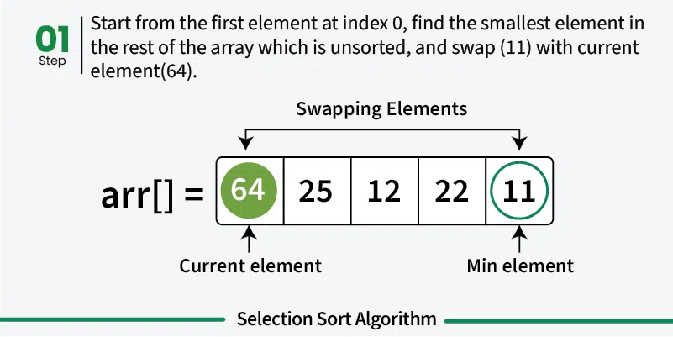
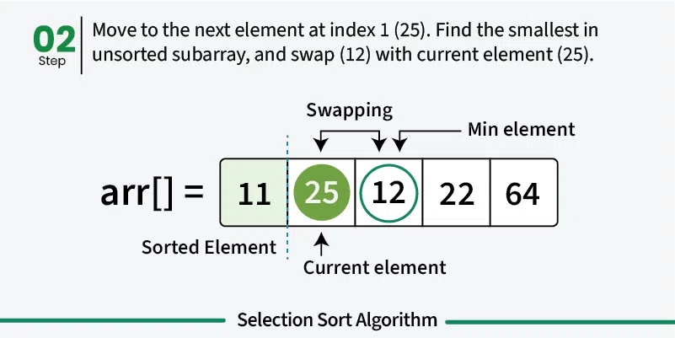
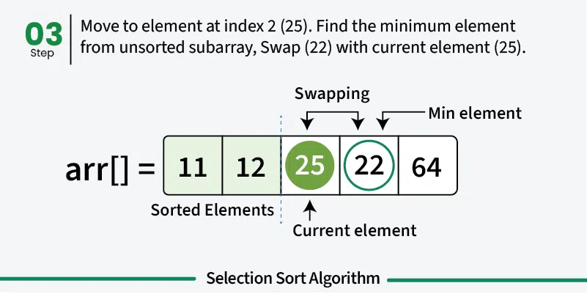
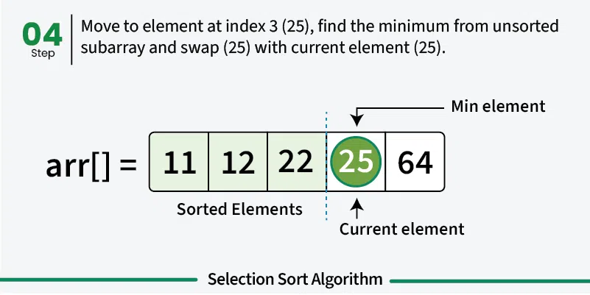
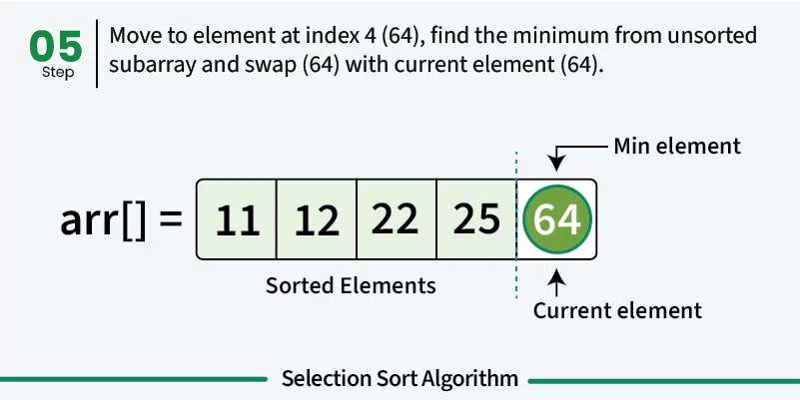
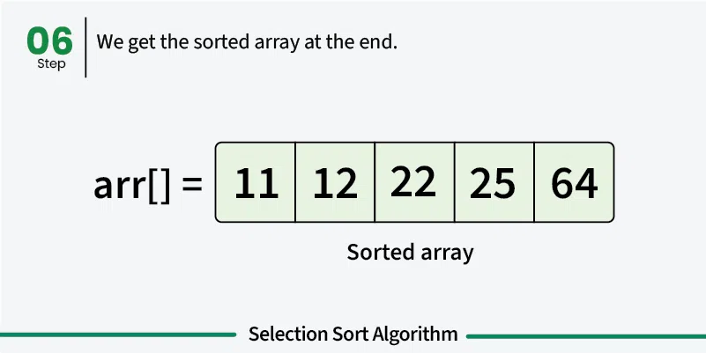

Slide 20
Principle 2: Divide and Conquer
General recipe:
Divide your work into smaller pieces recursively
Conquer the recursive subproblems
In many algorithms, conquering a subproblem requires no extra work beyond recursively dividing and combining it!
Combine the results of your recursive calls
divideAndConquer(input) {
if (small enough to solve):
conquer, solve, return results
else:
divide input into a smaller pieces
recurse on smaller pieces
combine results and return
}

Slide 21
Intro to Sorting
Selection Sort
Insertion Sort
Merge Sort
Quick Sort

Slide 22
Merge Sort
Merge sort is based on the principle of divide and conquer, by breaking down the problem into smaller sub-problems
Divide array into two halves. Recursively sort each half. Merge two halves
Merge Sort Algorithm: A Step-by-Step Visualization, Quoc Dat Phung
https://www.youtube.com/watch?v=ho05egqcPl4
0 | 1 | 2 | 3
55 | 1 | 7 | 6
0 | 1
55 | 1
0 | 1
7 | 6
0
55
0
1
0
7
0
6
0 | 1
1 | 55
0 | 1
6 | 7
0 | 1 | 2 | 3
1 | 6 | 7 | 55

Slide 23
Merge Sort
Divide
0 | 1 | 2 | 3 | 4 | 5 | 6 | 7
8 | 2 | 91 | 22 | 55 | 1 | 7 | 6
Divide in half each time
0 | 1 | 2 | 3
8 | 2 | 91 | 22
0 | 1 | 2 | 3
55 | 1 | 7 | 6
Conquer
…
0
8
0
2
0
91
0
22
0
55
0
1
0
7
0
6
Combine
…
0 | 1 | 2 | 3
2 | 8 | 22 | 91
0 | 1 | 2 | 3
1 | 6 | 7 | 55
Actual sorting happens here
0 | 1 | 2 | 3 | 4 | 5 | 6 | 7
1 | 2 | 6 | 7 | 8 | 22 | 55 | 91

Slide 24
Merge Sort: Divide Step
Divide
0 | 1 | 2 | 3 | 4 | 5 | 6 | 7
8 | 2 | 91 | 22 | 55 | 1 | 7 | 6
Recursive Case: split the array in half and recurse on both halves
0 | 1 | 2 | 3
8 | 2 | 91 | 22
0 | 1 | 2 | 3
55 | 1 | 7 | 6
0 | 1
8 | 2
0 | 1
91 | 22
0 | 1
55 | 1
0 | 1
7 | 6
When array hits size 1, stop dividing.
0
8
0
2
0
91
0
22
0
55
0
1
0
7
0
6
Sort the pieces through recursion
Notes:
In Merge Sort, no additional work to conquer: everything gets sorted in combine step!

Slide 25
Merge Sort: Combine Step
Combine
0 | 1 | 2 | 3
2 | 8 | 22 | 91
0 | 1 | 2 | 3
1 | 6 | 7 | 55
0 | 1 | 2 | 3 | 4 | 5 | 6 | 7
1
2
6
7
8
22
55
91
Combining two sorted arrays:
Initialize two pointers to start of both arrays
Repeat until all elements are added:
Add the smaller element of the two pointers to the result array
Move that pointer forward one spot
Notes:
Works because we only move the smaller pointer – then ”reconsider” the larger against a new value, and because the arrays are sorted we never have to backtrack!

Slide 26
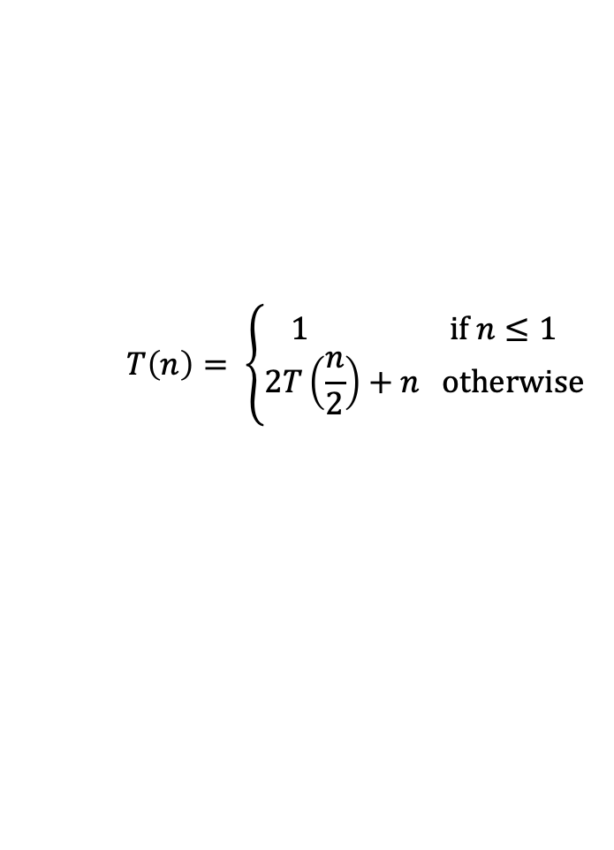

Merge Sort
n
0 | 1 | 2 | 3
55 | 1 | 7 | 6
mergeSort(list) {
if (list.length == 1):
return list
else:
smallerHalf = mergeSort(new [0, ..., mid])
largerHalf = mergeSort(new [mid + 1, ...])
return merge(smallerHalf, largerHalf)
}
0 | 1
55 | 1
0 | 1
7 | 6
2 log n
0
55
0
1
0
7
0
6
Worst case runtime?
Best case runtime?
In Practice runtime?
Stable?
In-place?
Useful for:
0 | 1
1 | 55
0 | 1
6 | 7
Same
Same
0 | 1 | 2 | 3
1 | 6 | 7 | 55
Yes
No
Predictable sort times regardless of sorted nature
Notes:
(This is what Java uses for Objects, kinda ) Don’t forget your old friends, the 3 recursive patterns!

Slide 27
Intro to Sorting
Selection Sort
Insertion Sort
Merge Sort
Quick Sort

Slide 28
Quick Sort
Quick Sort is based on the principle of divide and conquer: breaking down the problem into smaller sub-problems.
Choose a Pivot: Select an element from the array as the pivot. The choice of pivot can vary (e.g., first element, last element, random element, or median).
Partition the Array:
1. The pivot is compared with each element in the array. 2. Elements smaller than the pivot are moved to its left. 3. Elements larger than the pivot are moved to its right. 4. The pivot is placed in its final sorted position.
Recursively Call: Recursively apply the same process to the two partitioned sub-arrays (left and right of the pivot).
Base Case: The recursion stops when there is only one element left in the sub-array, as a single element is already sorted.
References
QuickSort | geeksforgeeks
https://www.geeksforgeeks.org/quick-sort-algorithm/
Quick sort in 4 minutes (recommended)
https://www.youtube.com/watch?v=Hoixgm4-P4M
Quicksort Algorithm: A Step-by-Step Visualization (recommended)
https://www.youtube.com/watch?v=pM-6r5xsNEY
QUICK SORT | Sorting Algorithms | DSA | GeeksforGeeks
https://www.youtube.com/watch?v=PgBzjlCcFvc
Notes:
Quicksort
Split into two arrays.
Roughly, elements that are “small” and elements that are “large”
How to define “small” and “large”? Choose a “pivot” value in the array that will partition the two arrays!
Partition Function of Quick Sort | GeeksforGeeks
https://www.youtube.com/watch?v=OwR53k9DZ9c
Quick Sort
Visualization of Quick sort (HD)
https://www.youtube.com/watch?v=aXXWXz5rF64

Slide 29
Quick Sort (v1)
Divide
0 | 1 | 2 | 3 | 4 | 5 | 6 | 7
8 | 2 | 91 | 22 | 55 | 1 | 7 | 6
PIVOT
Divide: Choose a “pivot” element, partition array relative to it
0 | 1 | 2 | 3
2 | 1 | 7 | 6
0
8
0 | 1 | 2
91 | 22 | 55
…
Conquer
0
1
0
2
0
6
0
7
0
8
0
22
0
55
0
91
Combine
…
0 | 1 | 2 | 3
1 | 2 | 6 | 7
0
8
0 | 1 | 2 | 3
1 | 6 | 7 | 55
Combine: Concatenate the now-sorted arrays
0 | 1 | 2 | 3 | 4 | 5 | 6 | 7
1 | 2 | 6 | 7 | 8 | 22 | 55 | 91

Slide 30
Quick Sort (v1): Divide Step
Divide
0 | 1 | 2 | 3 | 4 | 5 | 6 | 7
8 | 2 | 91 | 22 | 55 | 1 | 7 | 6
PIVOT
Recursive Case:
Choose a “pivot” element
Partition: linear scan through array, add smaller elements to one array and larger elements to another
Recursively partition
0 | 1 | 2 | 3
2 | 1 | 7 | 6
0
8
PIVOT
0 | 1 | 2
91 | 22 | 55
PIVOT
0
1
0
2
0 | 1
7 | 6
0 | 1
22 | 55
0
91
PIVOT
PIVOT
Base Case:
When array hits size 1, stop dividing
0
6
0
7
0
22
0
55

Slide 31
Quick Sort (v1): Combine Step
Combine
0
6
0
7
0
22
0
55
0
1
0
2
0 | 1
6 | 7
0 | 1
22 | 55
0
91
Simply concatenate the arrays that were created earlier. Partition step already left them in order
0 | 1 | 2 | 3
1 | 2 | 6 | 7
0
8
0 | 1 | 2
22 | 55 | 91
0 | 1 | 2 | 3 | 4 | 5 | 6 | 7
1 | 2 | 6 | 7 | 8 | 22 | 55 | 91

Slide 32
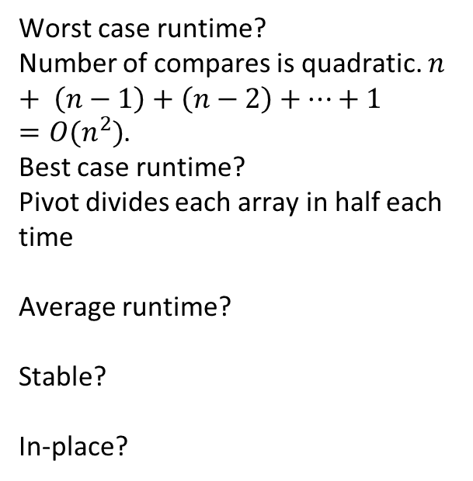



Quick Sort (v1)
Worst case: Pivot only chops off one value
Best case: Pivot divides each array in half
0 | 1 | 2 | 3
2 | 1 | 7 | 6
quickSort(list) {
if (list.length == 1):
return list
else:
pivot = choosePivot(list)
smallerHalf = quickSort(getSmaller(pivot, list))
largerHalf = quickSort(getBigger(pivot, list))
return smallerHalf + pivot + largerHalf
}
PIVOT
0
1
0
2
0 | 1
7 | 6
PIVOT
0
6
0
7
Worst case runtime?
Number of compares is quadratic. $n+ \left(n−1\right)+\left(n−2\right)+…+1=O(n^{2})$.
Best case runtime?
Pivot divides each array in half each time
Average runtime?
Stable?
In-place?
$$O(n^{2})$$
0 | 1
6 | 7
$$O(n\log{n})$$
0 | 1 | 2 | 3
1 | 2 | 6 | 7
$O(n\log{n})$ (non-trivial derivation)
No
No
Notes:
Fast sorting of primitives!
(This is what Java uses for Primitives)

Slide 33
Strategies for Choosing a Pivot
Just take the first element
Very fast!
But has worst case: for example, sorted lists have Ω(n²) runtime
Take the median of the full array
Can find the median in O(n) time (QuickSelect). It’s complicated
Worst case is O(n log n) … but the constant factors are large. No one does quicksort this way.
Take the median of the first, last, and middle element
Makes pivot slightly more content-aware, at least won’t select very smallest/largest
Worst case is still O(n²) , but on real-world data tends to perform well!
Pick a random element
Get O(n log n) runtime with probability at least 1-1/n²
No simple worst-case input (e.g. sorted, reverse sorted)
Notes:
How to avoid hitting the worst case?
It depends on pivot selection. If the pivot divides each array in half, we get better behavior
Here are four options for finding a pivot. What are the tradeoffs?
Just take the first element
Take the median of the full array
Take the median of the first, last, and middle element
Pick a random element
The pivot is an element chosen from the array that serves as a reference point for partitioning the array into two subarrays. There are several strategies for selecting the pivot:
###First or Last Element as Pivot. Simple to implement but can lead to poor performance if the array is already sorted or nearly sorted.
### Random Element as Pivot. This can help avoid worst-case scenarios and provide more consistent performance across different input distributions.
### Median-of-Three. This method selects the median of the first, middle, and last elements of the array as the pivot. It provides a good balance between simplicity and performance.

Slide 34
Quick Sort (v2: In-Place)
Divide
0 | 1 | 2 | 3 | 4 | 5 | 6 | 7 | 8 | 9
8 | 1 | 4 | 9 | 0 | 3 | 5 | 2 | 7 | 6
PIVOT?
PIVOT!
PIVOT?
PIVOT?
Select a pivot
0 | 1 | 2 | 3 | 4 | 5 | 6 | 7 | 8 | 9
6 | 1 | 4 | 9 | 0 | 3 | 5 | 2 | 7 | 8
Move pivot out of the way
Bring low and high pointers together, swapping elements if needed
Low
X < 6
High
X >= 6
0 | 1 | 2 | 3 | 4 | 5 | 6 | 7 | 8 | 9
6 | 1 | 4 | 2 | 0 | 3 | 5 | 9 | 7 | 8
Meeting point is where pivot belongs; swap in. Now recurse on smaller portions of same array!
Low
X < 6
High
X >= 6
0 | 1 | 2 | 3 | 4 | 5 | 6 | 7 | 8 | 9
5 | 1 | 4 | 2 | 0 | 3 | 6 | 9 | 7 | 8

Slide 35
Heap Sort
Bucket Sort
Radix Sort
Sorting Summary

Slide 36



Heap Sort
HEAP-sort with Hungarian (MEZŐSÉGI) folk dance
https://www.youtube.com/watch?v=Xw2D9aJRBY4
1. run Floyd’s buildHeap on your data
2. call removeMin n times
public void heapSort(input) {
E[] heap = buildHeap(input)
E[] output = new E[n]
for (n)
output[i] = removeMin(heap)
}
Worst case runtime?
Best case runtime?
Average runtime?
Stable?
In-place?
$$O\left(n\log{n}\right)$$
$$O\left(n\right)$$
$$O\left(n\log{n}\right)$$
No
If we get clever…

Slide 37
Principle 3
Selection sort:
After k iterations of the loop, the k smallest elements of the array are (sorted) in indices 0, … , k-1
Runs in O(n²) time no matter what
Using data structures
Speed up our existing ideas
If only we had a data structure that was good at getting the smallest item remaining in our dataset…
We do!

Slide 38
In Place Heap Sort
0 | 1 | 2 | 3 | 4 | 5 | 6 | 7 | 8 | 9
1 | 4 | 2 | 14 | 15 | 18 | 16 | 17 | 20 | 22
Heap
Sorted Items
Current Item
0 | 1 | 2 | 3 | 4 | 5 | 6 | 7 | 8 | 9
22 | 4 | 2 | 14 | 15 | 18 | 16 | 17 | 20 | 1
percolateDown(22)
Heap
Sorted Items
Current Item
0 | 1 | 2 | 3 | 4 | 5 | 6 | 7 | 8 | 9
2 | 4 | 16 | 14 | 15 | 18 | 22 | 17 | 20 | 1
Heap
Sorted Items
Current Item

Slide 39



In Place Heap Sort
0 | 1 | 2 | 3 | 4 | 5 | 6 | 7 | 8 | 9
15 | 17 | 16 | 18 | 20 | 22 | 14 | 4 | 2 | 1
Heap
Sorted Items
Current Item
public void inPlaceHeapSort(input) {
buildHeap(input) // alters original array
for (n : input)
input[n – i - 1] = removeMin(heap)
}
Worst case runtime?
Best case runtime?
Average runtime?
Stable?
In-place?
$$O\left(n\log{n}\right)$$
$$O\left(n\right)$$
$$O\left(n\log{n}\right)$$
Complication: final array is reversed! Lots of fixes:
Run reverse afterwards O(n)
Use a max heap
Reverse compare function to emulate max heap
No
Yes

Slide 40
Heap Sort
Bucket Sort
Radix Sort
Sorting Summary

Slide 41
Bucket Sort (aka Bin Sort)
If all values are ints known to be in the range of 1 - K
Create array of size K and put each element in its proper bucket (“scatter”)
If elements are only ints simply store count of ints in each bucket
Output results via linear pass through array of buckets (“gather”)
[5, 1, 3, 4, 3, 2, 1, 1, 5, 4, 5]
1 | 3
2 | 1
3 | 2
4 | 4
5 | 3
O(K + n)
O(n)
[1, 1, 1, 2, 3, 3, 4, 4, 5, 5, 5]
Total Runtime: O(K + n)

Slide 42
Bucket Sort with Data
Bucket Sort | GeeksforGeeks
https://www.youtube.com/watch?v=VuXbEb5ywrU
Make buckets of array of lists
Put items into bucket, use insertion sort to sort individual buckets
[0.78, 0.17, 0.39, 0.26, 0.72, 0.94, 0.21, 0.12, 0.23, 0.68]
0
1
2
3
4
5
6
7
8
9
0
1
2
3
4
5
6
7
8
9
0.17
0.12
0.12
0.17
O(n)
0.26
0.21
0.23
0.21
0.23
0.26
0.39
0.39
worst: O(K + n²)
best: O(K)
O(K + n)
0.68
0.68
0.78
0.72
0.72
0.78
[0.12, 0.17, 0.21, 0.23, 0.26, 0.39, 0.68, 0.72, 0.78, 0.94]
0.94
0.94

Slide 43
Bucket Sort
function bucketSort(array, k) is
buckets ← new array of k empty lists
M ← 1 + the maximum key value in the array
for i = 0 to length(array) do
insert array[i] into buckets[floor(k × array[i] / M)]
for i = 0 to k do
nextSort(buckets[i])
return the concatenation of buckets[0], ...., buckets[k]
Worst case runtime?
Best case runtime?
Average runtime?
Stable?
In-place?
Useful for:
O(K + n) for ints
O(K + n²) for data if insertion sort is used
O(n)
O(n) if K ≅ n, always for ints, and if values are evenly distributed for data
Can be because insertion sort
No
When range, K, is smaller or not much larger than n (not many duplicates)
Not good when K >> N, wasted space

Slide 44
Heap Sort
Bucket Sort
Radix Sort
Sorting Summary

Slide 45
Moving away from comparison sorts
So far we’ve learned about comparison sorts
work on any comparable object
have a best case lower bound of O(n log n)
This is because to sort using comparisons requires all elements to be compared against one another
n runtime to process all values into some ordered structure (tree)
logn runtime to remove items from structure in sorted order
What if we didn’t need to compare each element, what if we built a sort based on inherent knowledge about the ordering of specific data types ie numbers

Slide 46
Specialized Sorts (“Niche Sorts”)
Sorting algorithms that only work on data types with ordering already known to computer logic: numbers
Bucket Sort for ints
Radix Sort

Slide 47
Radix Sort
Bucket Sort | GeeksforGeeks
https://www.youtube.com/watch?v=nu4gDuFabIM
Radix = “the base of a number system”
We will use “10” as we are comfortable with 10 based systems
Could use any value, such as 128 for ASCII strings
Idea
Bucket sort on one digit at a time
Only works on sequences of countable data: ints, doubles, stings
Number of buckets = radix
Start with least significant digit, do one pass of bucket sort per digit
Fun fact: invented in 1890 as part of US census
Input:
[170, 45, 75, 90, 802, 24, 2, 66]
ones:
[170, 90, 802, 2, 24, 45, 75, 66]
tens:
[802, 2, 24, 45, 66, 170, 75, 90]
hundreds:
[2, 24, 45, 66, 75, 90, 170, 802]

Slide 48
Radix Sort
[478, 537, 9, 721, 3, 38, 143, 67]
[721, 3, 143, 537, 67, 478, 38, 9]
[3, 9, 721, 537, 38, 143, 67, 478]
0
1 | 721
2
3 | 3, 143
4
5
6
7 | 537, 67
8 | 478, 38
9 | 9
0 | 03, 09
1
2 | 721
3 | 537, 38
4 | 143
5
6 | 67
7 | 478
8
9
0 | 003, 009, 038, 067
1 | 143
2
3
4 | 478
5 | 537
6
7 | 721
8
9
O(n)
O(n)
O(n)
O(n)
O(n)
O(n)
[3, 9, 38, 67, 143, 478, 537, 721]

Slide 49
Radix Sort
Worst case runtime?
Best case runtime?
Average runtime?
Stable?
In-place?
Useful for:
O(n)
O(n)
O(n)
Yes
No
Sorting ints

Slide 50
Heap Sort
Bucket Sort
Radix Sort
Sorting Summary

Slide 51
Sorting: Summary
No single sorting algorithm is “the best”!
Different algos have different properties in different situations
The best one is one that is well-suited to your data
 | Best-Case | Worst-Case | Space | Stable
Selection Sort | O(n²) | O(n²) | O(1) | No
Insertion Sort | O(n) | O(n²) | O(1) | Yes
Heap Sort | O(nlogn) | O(nlogn) | O(n) | No
In-Place Heap Sort | O(nlogn) | O(nlogn) | O(1) | No
Merge Sort | O(nlogn) | O(nlogn) | O(nlogn) O(n)* optimized | Yes
Quick Sort | O(nlogn) | O(n²) | O(n) | No
In-place Quick Sort | O(nlogn) | O(n²) | O(1) | No
Bucket Sort | O(n) | O(n²) | O(K+n) | Yes
Radix | O(n) | O(n) | O(n) | Yes
Notes:
What does Java do?
A combination of 3 different sorts:
If objects: use Merge Sort* (stable!)
If primitives: use Dual Pivot Quick Sort
For short arrays, use Insertion Sort
* They actually use Tim Sort, which is very similar to Merge Sort in theory, but has some minor details different

Slide 52
References
Quicksort: Partitioning an array, KC Ang
https://www.youtube.com/watch?v=MZaf_9IZCrc

Slide 53
References
Sort Algos // Michael Sambol Michael Sambol
https://www.youtube.com/playlist?list=PL9xmBV_5YoZOZSbGAXAPIq1BeUf4j20pl
Merge Sort, Quick Sort, Bubble Sort, Insertion Sort, Selection Sort, Heap Sort
10 Sorting Algorithms Easily Explained
https://www.youtube.com/watch?v=rbbTd-gkajw
Bubble Sort, Selection Sort, Insertion Sort, Merge Sort, Quick Sort, Heap Sort, Counting Sort, Shell Sort, Tim Sort, Radix Sort
Radix Sort Algorithm Introduction in 5 Minutes, CS Dojo
https://www.youtube.com/watch?v=XiuSW_mEn7g

